Slide 1
Servlet

Slide 2
What are Servlets?
Java Servlets are programs that run on a Web server and act as a middle layer between a request coming from a Web browser or other HTTP client and databases or applications on the HTTP server.
Using Servlets, you can collect input from users through web page forms, present records from a database or another source, and create web pages dynamically.

Slide 3
Servlets
The purpose of a servlet is to create a Web page in response to a client request
Servlets are written in Java, with a little HTML mixed in The HTML is enclosed in out.println( ) statements

Slide 4
Servlet process flow
Request
Response JDBC
Web Server
Servlet
Data Base
Client

Slide 5
HTTP Request
When a request is submitted from a Web page, it is almost always a GET or a POST request
The HTTP <form> tag has an attribute action, whose value can be "get" or "post"
The "get" action results in the form information being put after a ? in the URL
Example:
http://www.google.com/search?hl=en&ie=UTF-8&oe=UTF-8&q=servlets
The & separates the various parameters
Only a limited amount of information can be sent this way
"post" can send large amounts of information

Slide 6
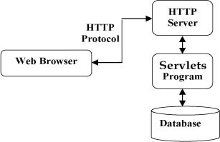
Servlets Architecture:

Slide 7
Servlet API
The API is composed of two packages:
❑javax.servlet
❑javax.servlet.http
The javax.servlet package contains classes to support generic protocol-independent servlets. This means that servlets can be used for many
protocols, for example, HTTP and FTP.
The javax.servlet.http package extends the functionality of the base package to include specific support for the HTTP protocol.

Slide 8
Types of Servlets
Servlets must implement the interface javax.servlet.Servlet.
There are two main types of servlets:
  Generic servlets extend javax.servlet.GenericServlet. Generic servlets are protocol independent, meaning that they contain no inherent support for HTTP or any other transport protocol.
  HTTP servlets extend javax.servlet.http.HttpServlet. These servlets have built-in support for the HTTP protocol and are much more useful in an Browser environment

Slide 9
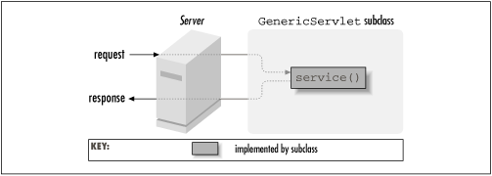
A generic servlet handling a request

Slide 10
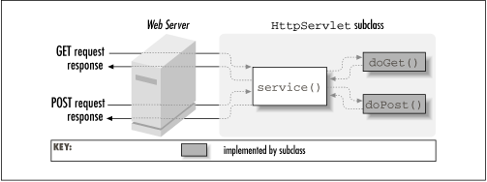
An HTTP servlet handling GET and POST requests

Slide 11
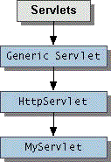
Servlet Hierarchy

Slide 12
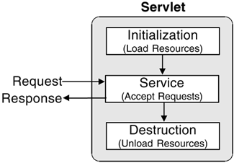
Servlets life cycle

Slide 13
The init() method :
The init method is designed to be called only once. It is called when the servlet is first created, and not called again for each user request. So, it is used for one-time initializations, just as with the init method of applets.
public void init()
{
// Initialization code...
}

Slide 14
The service() method :
The service() method is the main method to perform the actual task. The servlet container (i.e. web server) calls the service() method to handle requests coming from the client( browsers) and to write the formatted response back to the client.
public void service(ServletRequest request,
ServletResponse response)
{ }

Slide 15
The doGet() Method
A GET request results from a normal request for a URL or from an HTML form that has no METHOD specified and it should be handled by doGet() method.
public void doGet(HttpServletRequest request,
HttpServletResponse response)
{
// Servlet code
}

Slide 16
The doPost() Method
A POST request results from an HTML form that specifically lists POST as the METHOD and it should be handled by doPost() method.
public void doPost(HttpServletRequest request,
HttpServletResponse response)
{
// Servlet code
}

Slide 17
The destroy() method :
The destroy() method is called only once at the end of the life cycle of a servlet.
public void destroy() {
// Finalization code...
}

Slide 18
Simple Example
import java.io.*;import javax.servlet.*;import javax.servlet.http.*;
public class SimpleHttpServlet extends HttpServlet {
public void service(ServletRequest req,ServletResponse res)throws ServletException, IOException {
res.setContentType("text/html");
PrintWriter out = res.getWriter(); out.println("<HTML><BODY>");
out.println("<H2>My First Servlet </H2><HR>");
out.println("</BODY><HTML>");
out.close();
} }

Slide 19
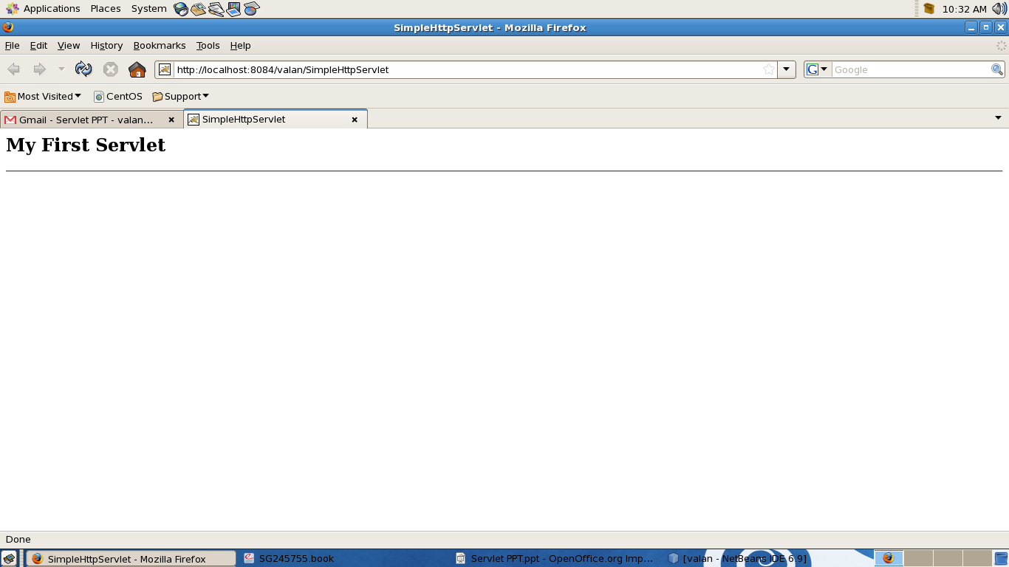
Output

Slide 20
Basic servlet structure
import java.io.*;
import javax.servlet.*;
import javax.servlet.http.*;
The import statements used to give us access to other Java packages. The import of java.io is so that we have access to some standard IO classes. More importantly, the javax.servlet.* and javax.servlet.http.* import statements give us access to the Java Servlet API set of classes and interfaces.

Slide 21
Basic servlet structure Cont...
public class SimpleHttpServlet extends HttpServlet {
We extend the HttpServlet class (javax.servlet.http.HttpServlet) to make our class an HTTP protocol servlet.

Slide 22
Basic servlet structure cont..
public void service(HttpServletRequest req, HttpServletResponse res)
throws ServletException, IOException {
res.setContentType("text/html");
PrintWriter out = res.getWriter(); out.println("<HTML><BODY>");
out.println("<H2>My First Servlet </H2><HR>");
out.println("</BODY><HTML>");
out.close();
}
It is the heart of this servlet, the implementation of the service method for the handling of the request and response objects of the servlet.

Slide 23
What the service method does
Notice that the method accepts two parameters,
ServletRequest and ServletResponse.
The request object contains information about and from the client. In this example, we don’t do anything with the request.

Slide 24
What the service method does cont...
We do some handling of the response object, which is responsible for sending our response back to the client.
Our response here is a formatted HTML page, so we first set the response content type to text/html by coding res.setContentType("text/html").
Next, we request a PrintWriter object to write text to the response by coding PrintWriter out =res.getWriter().
The remaining out.println statements write our HTML to the PrintWriter, which is sent back to the client as our response.

Slide 25
Servlets - Form Data

Slide 26
Getting form values
We use the getParameter method of the request to extract the values of the request parameters .
req.getParameter("firstname")
req.getParameter("title")

Slide 27
Example 1
<html><body>
<h2>Login</h2>
<p>Please enter your username and password</p>
<form method="POST" action="LoginServlet">
Username <input type="text" name="username"><br>
Password <input type="password" name="password">
<br>
<input type="submit" value="Submit" name="B1">
</form></body></html>

Slide 28
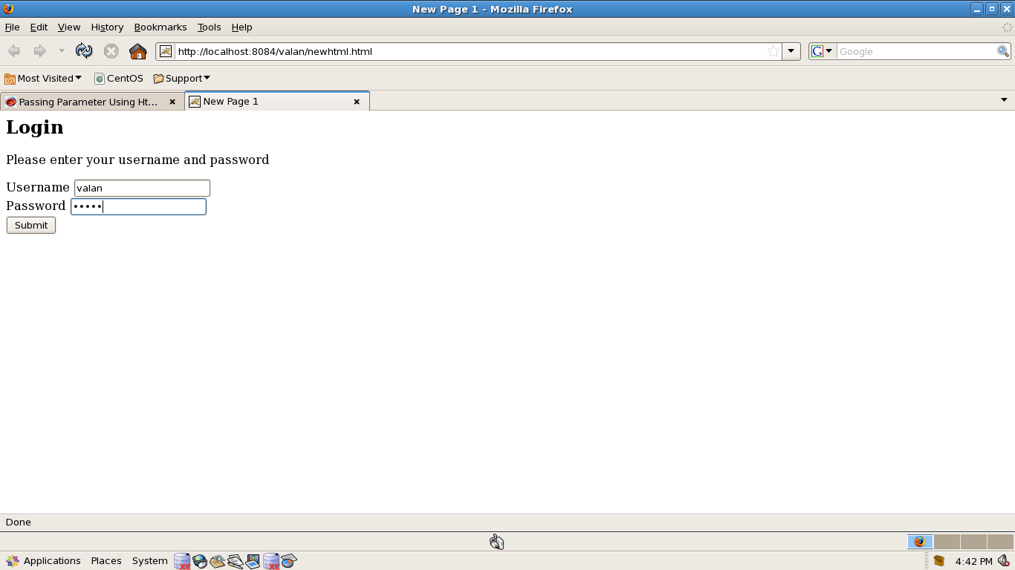
Example 1 Cont...

Slide 29
Example 1 Cont..
import java.io.*;import javax.servlet.*;import javax.servlet.http.*;
public class LoginServlet extends HttpServlet{
public void doPost(HttpServletRequest request, HttpServletResponse response) throws ServletException, IOException {
PrintWriter out = response.getWriter();
String name = request.getParameter("username");
String pass = request.getParameter("password");
out.println("<html>");
out.println("<body><h3>");
out.println("Thanks Mr.<font color=blue>" + " " + name + "</font> " + "for visiting roseindia<br>" );
out.println("Now you can see your password :<font color=blue> " + " " + pass + "</font><br>");
out.println("</h3></body></html>"); } }

Slide 30
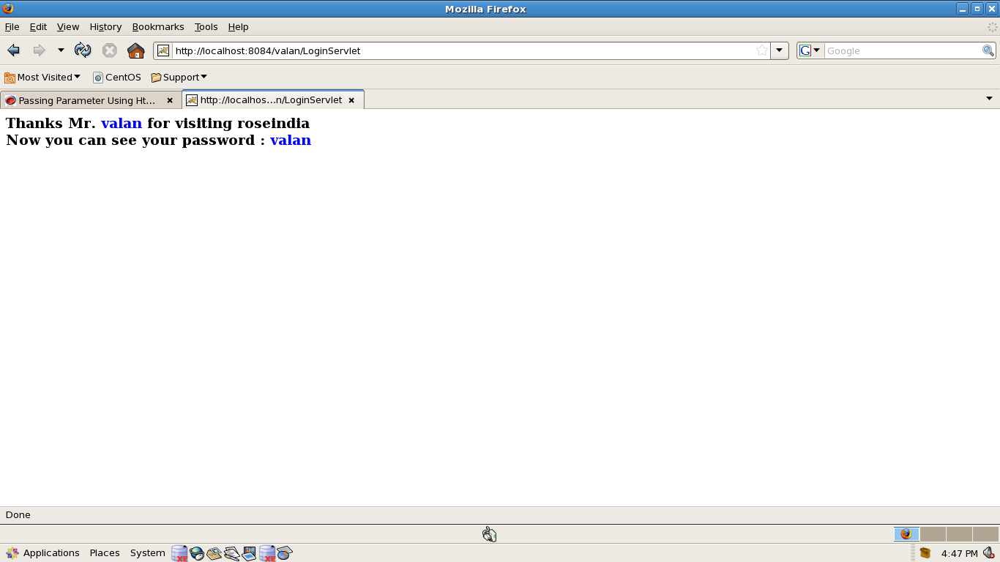
Example 1 Cont...

Slide 31
Example 2: Multiple values for a single parameter
<html><body>
<form method = "get" action = "MyServlet">
<p>Which of the color you like most</p>
<input type = "checkbox" name ="c1" value = "Red">Red
<br>
<input type = "checkbox" name ="c1" value = "Green">Green
<br>
<input type = "checkbox" name ="c1" value = "Blue">Blue
<br>
<input type ="submit" name= "submit">
</form> </body> </html>

Slide 32
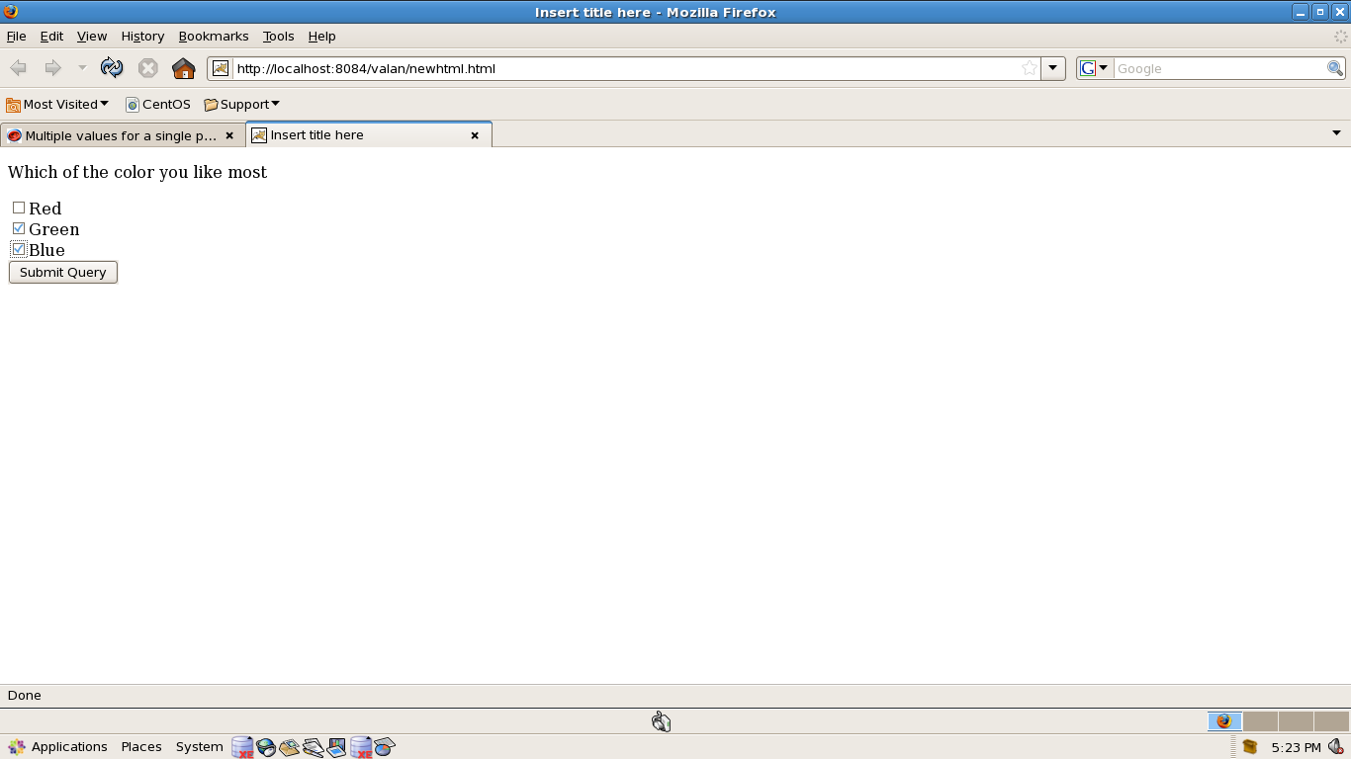
Example 2 Cont...

Slide 33
Example 2 Cont..
import java.io.*;import javax.servlet.*;
import javax.servlet.http.*;
public class LoginServlet extends HttpServlet{
protected void doGet(HttpServletRequest request, HttpServletResponse response)
throws ServletException, IOException {
PrintWriter pw = response.getWriter();
String s[] = request.getParameterValues("c1");
for(int i=0; i<s.length; i++){
pw.println("<h3>"+"Color : "+ s[i]+"</h3><br>");
} } }

Slide 34
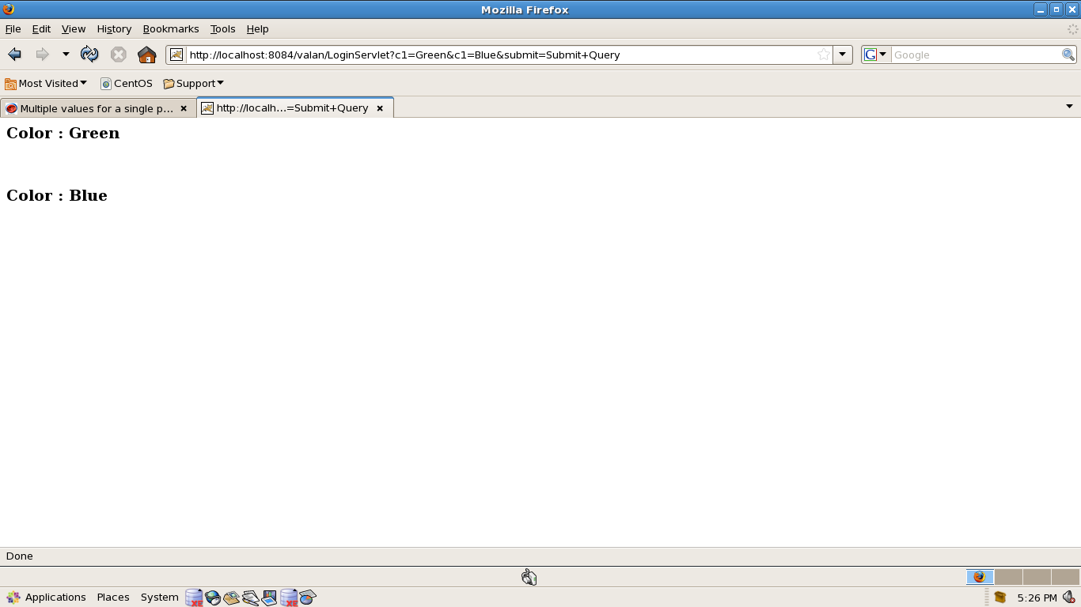
Example 2 Cont...

Slide 35
Session Tracking

Slide 36
Hidden Form Fields:
This is one of the way to support the session tracking. As we know by the name, that in this fields are added to an HTML form which are not displayed in the client's request. The hidden form field are sent back to the server when the form is submitted.
In hidden form fields the html entry will be like this :
<input type ="hidden" name = "name" value="">

Slide 37
URL Rewriting:
This is another way to support the session tracking.
URLRewriting can be used in place where we don't want to use cookies.
It is used to maintain the session.

Slide 38
Example: URL Rewriting
<html>
<body><h2>
<form method="POST" action="RewriteServletURL">
Enter your name:<input type="text" name="user">
<br>
<input type="submit" value="Submit">
</form></h2></body>
</html>

Slide 39
Example :URL Rewriting
import java.io.*; import javax.servlet.*;
import javax.servlet.http.*;
public class RewriteServletURL extends HttpServlet{
public void doPost(HttpServletRequest req, HttpServletResponse
res) throws ServletException, IOException {
String username = req.getParameter("user");
PrintWriter pw = res.getWriter();
res.setContentType("text/html");
pw.println("<h2>Hello! <a href=\"SecondServlet?uname="+ username + "\"> click here </a>to proceed</h2>"); } }

Slide 40
Example: URL Rewriting
import java.io.*; import javax.servlet.*;
import javax.servlet.http.*;
public class SecondServlet extends HttpServlet {
public void doGet(HttpServletRequest req, HttpServletResponse
res) throws ServletException, IOException {
String uname = req.getParameter("uname");
PrintWriter pw = res.getWriter();
pw.println("<h2>Hello! "+uname+"</h2>");
} }

Slide 41
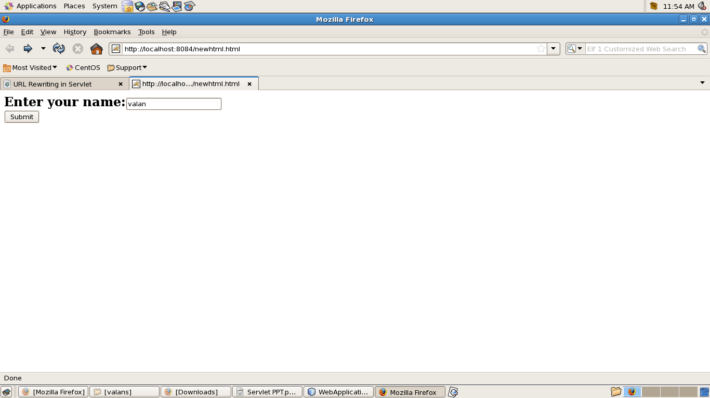
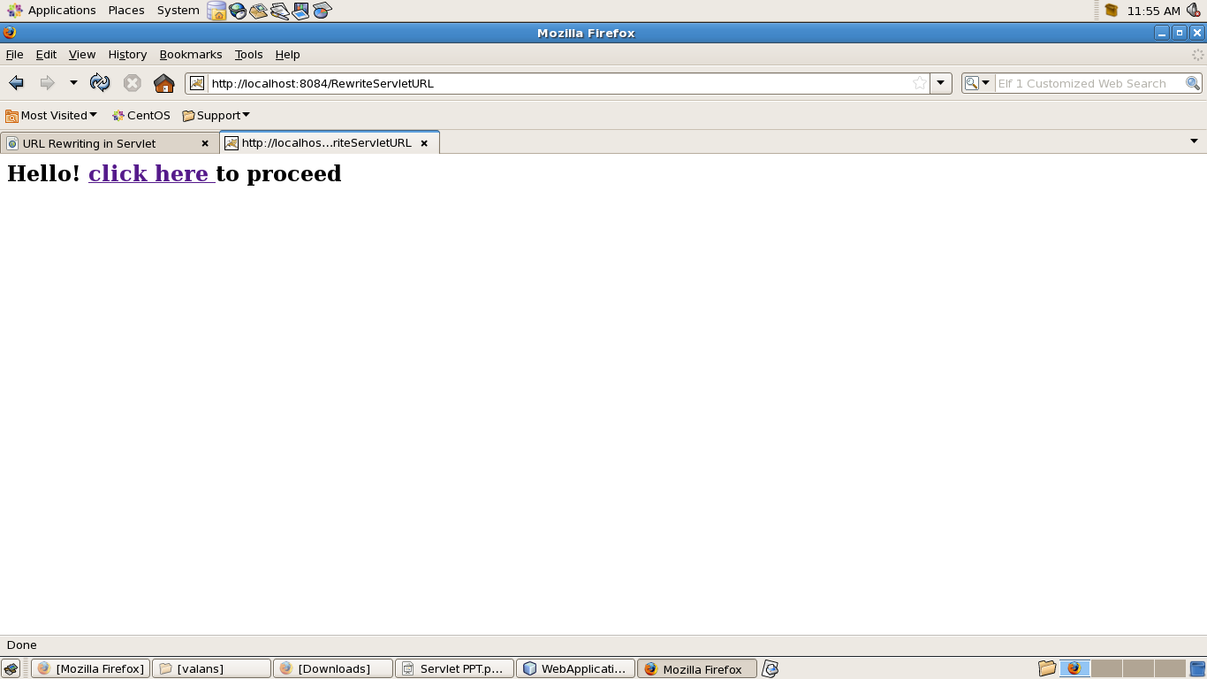
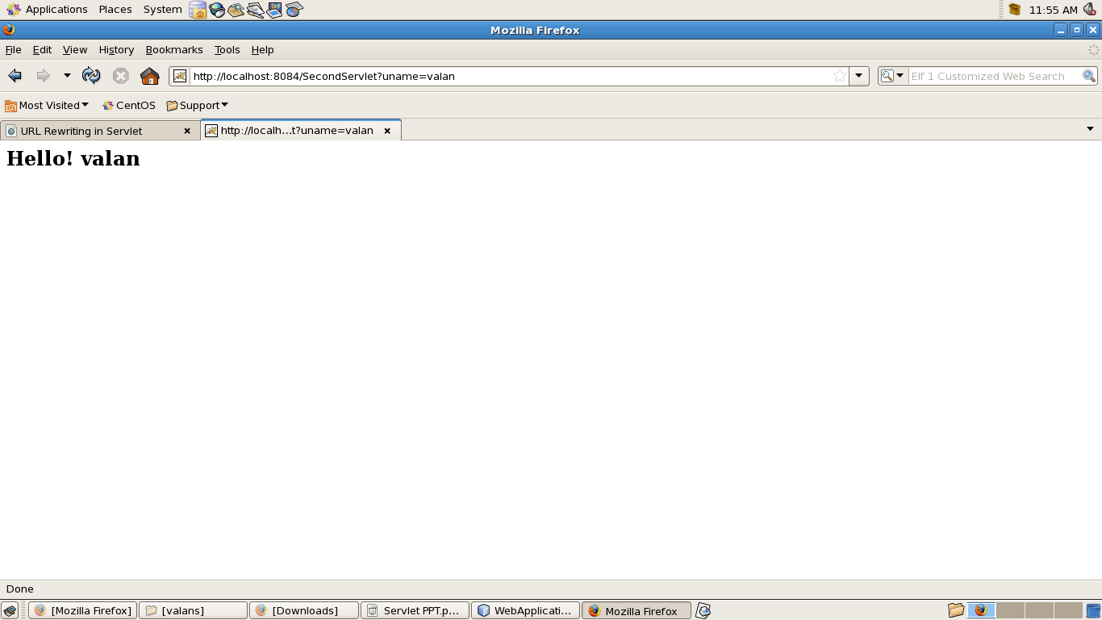
Output: URL Rewriting

Slide 42
Cookies:
When cookie based session management is used, a token is generated which contains user's information, is sent to the browser by the server. The cookie is sent back to the server when the user sends a new request.
By this cookie, the server is able to identify the user. In this way the session is maintained. Cookie is nothing but a name- value pair, which is stored on the client machine.

Slide 43
Example: Cookie
<html> <body>
<form method="POST" action="writecookie">
Enter your name:<input type="text" name="user">
<br>
<input type="submit" value="Submit">
</form>
</body></html>

Slide 44
Example: Cookie
import java.io.*; import javax.servlet.*;
import javax.servlet.http.*;
public class writecookie extends HttpServlet {
public void doPost(HttpServletRequest req, HttpServletResponse
res) throws ServletException, IOException {
String username = req.getParameter("user");
PrintWriter pw = res.getWriter();
res.setContentType("text/html");
Cookie c=new Cookie("user",username);
res.addCookie(c);
pw.println("<a href='readcookie'> click here </a>"); } }

Slide 45
Example: Cookie
import java.io.*;import javax.servlet.*;
import javax.servlet.http.*;
public class readcookie extends HttpServlet {
public void doGet(HttpServletRequest req, HttpServletResponse
res) throws ServletException, IOException {
PrintWriter pw = res.getWriter();
Cookie c[]=req.getCookies();
pw.println("Hello! "+c[0].getValue());
} }

Slide 46
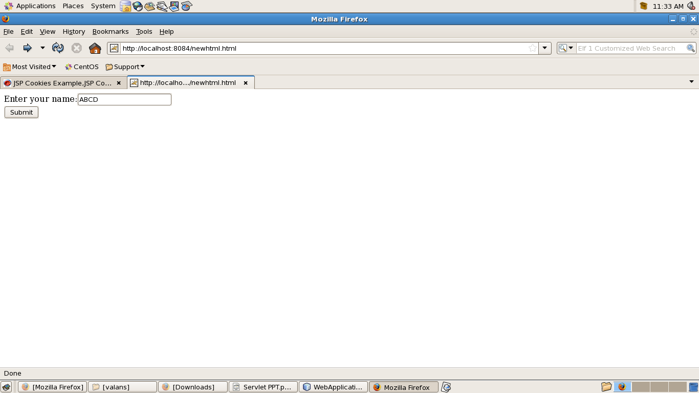
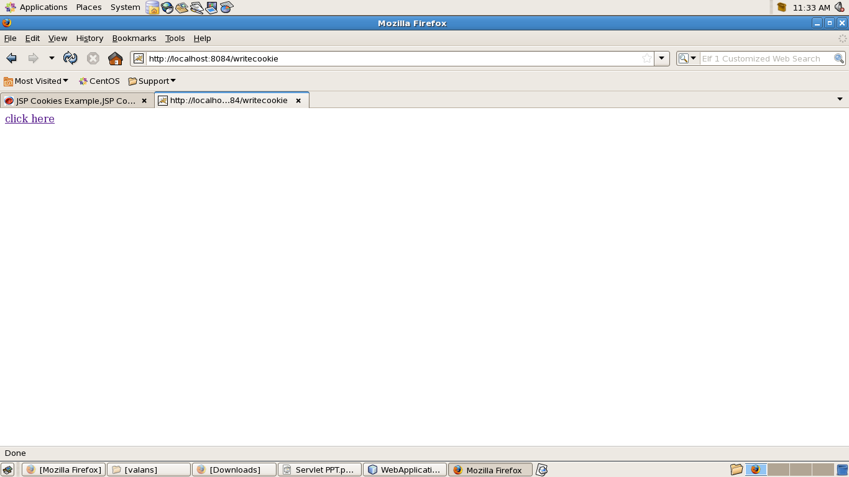
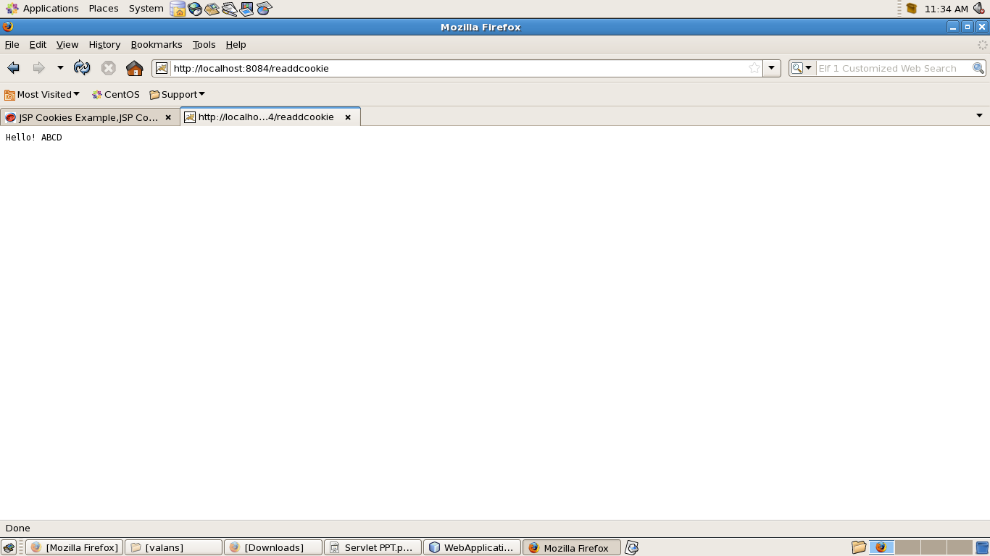
Output: Cookie

Slide 47
Example 3:Session
<html>
<body>
<form method="post" action="SimpleHttpServlet">
<input type="text" name="t1">
<input type="submit" value="go"/>
</form>
</body>
</html>

Slide 48
Example 3 Cont...
import java.io.*;import javax.servlet.*;import javax.servlet.http.*;
public class SimpleHttpServlet extends HttpServlet {
public void doPost(HttpServletRequest req, HttpServletResponse res)throws ServletException, IOException {
res.setContentType("text/html");
PrintWriter out = res.getWriter();
String s=req.getParameter("t1");
HttpSession session = req.getSession();
session.setAttribute("name",s);
out.println("<a href='sessionjava'/> Session demo</a>");
out.close(); } }

Slide 49
Example 3 Cont..
import java.io.*;import javax.servlet.*;
import javax.servlet.http.*;
public class sessionjava extends HttpServlet {
public void service(HttpServletRequest req, HttpServletResponse res)
throws ServletException, IOException {
res.setContentType("text/html");
PrintWriter out = res.getWriter();
HttpSession session=req.getSession();
out.println("<h2> Value :"+session.getAttribute("name")+"</h2>");
out.close();
} }

Slide 50
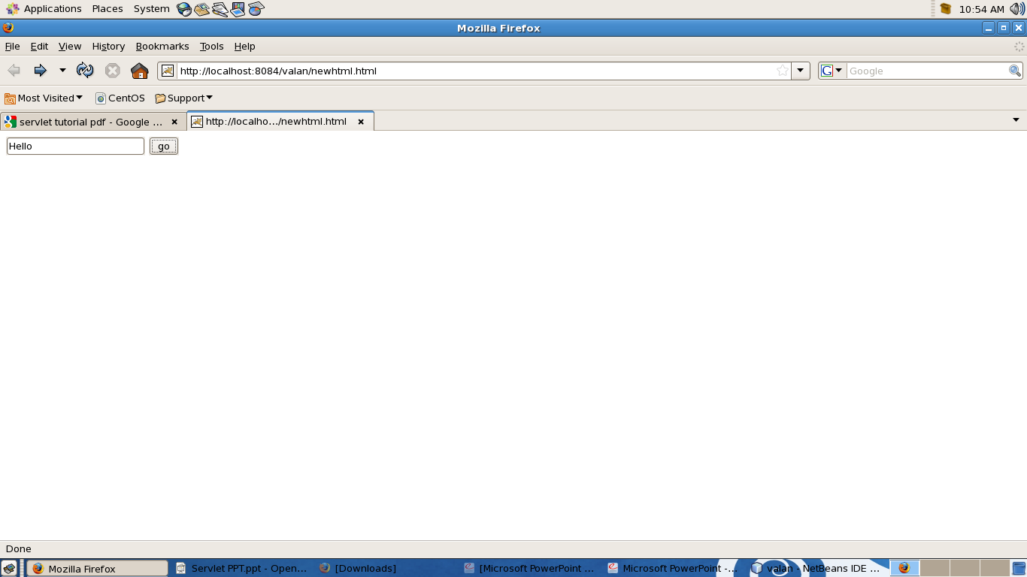
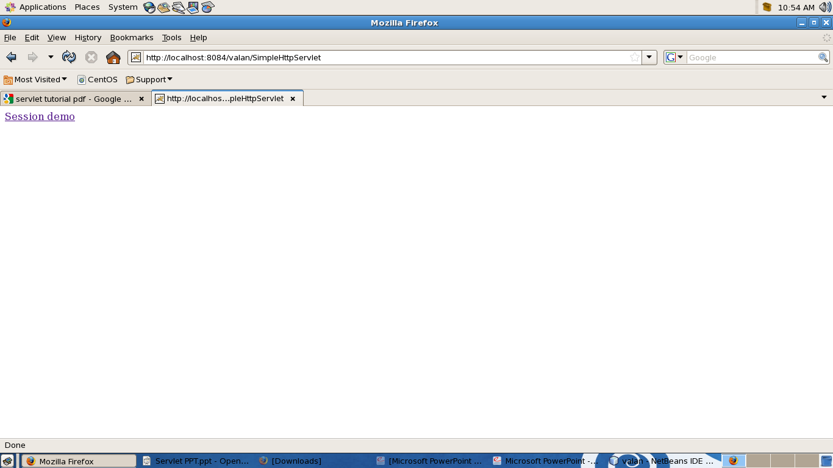
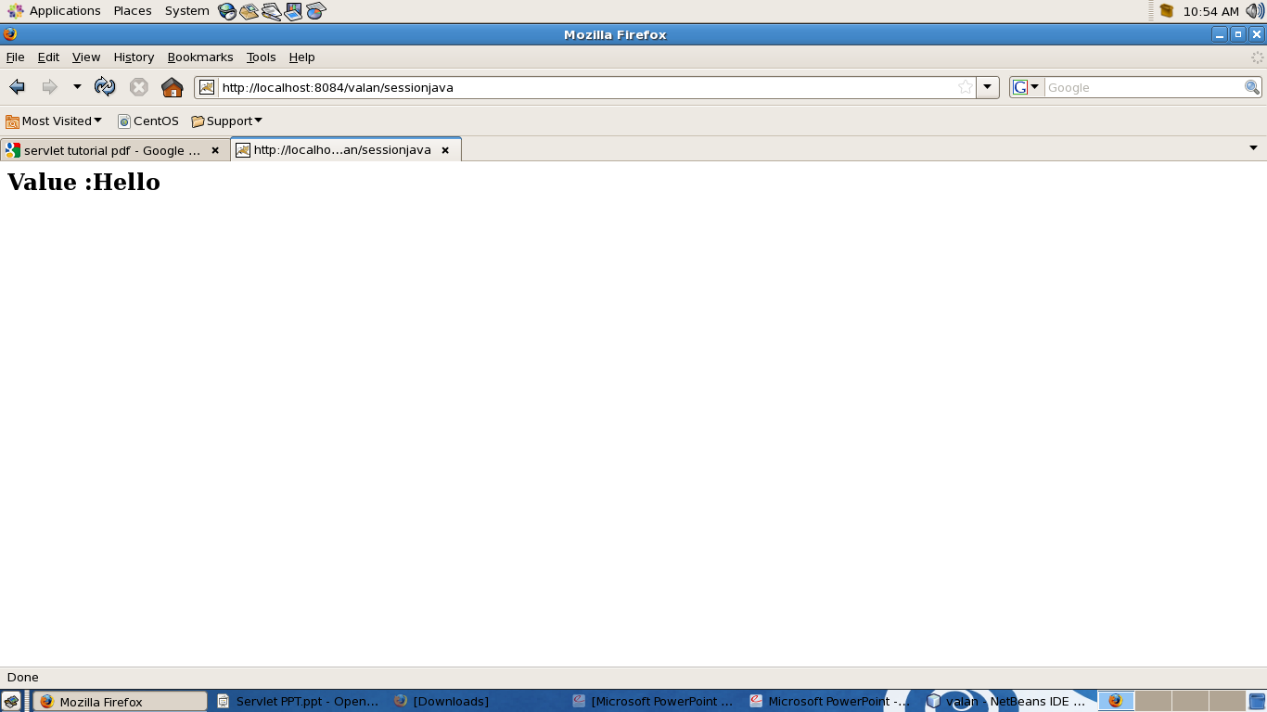
Example 3 Cont...

Slide 51
Servlet Config & Servlet Context

Slide 52
Servlet Config Vs Servlet Context
Servlet Config is a private area for every servlet(variable declared here are accessible only 2 that particular servlet)
While Servlet Context is a shared area for every servlet in an application i.e., all the servlet's in this application can access this variables in servlet context,an best example for this is,we can keep variables like database connection objects

Slide 53
Example:Servlet Config
import javax.servlet.*; import java.io.*;
public class servletconfig extends GenericServlet {
String s,s1;
public void init(ServletConfig sc) {
s=sc.getServletName();
s1=sc.getInitParameter("email"); }
public void service(ServletRequest request, ServletResponse response)
throws ServletException, IOException{
PrintWriter pw=response.getWriter();
response.setContentType("text/html");
pw.println("Servlet Name:"+s+"<br>");
pw.println("parameter value:"+s1);
} }

Slide 54
Example : Servlet Config
web.xml
<servlet>
<servlet-name>servletconfig</servlet-name>
<servlet-class>servletconfig</servlet-class>
<init-param>
<param-name>email</param-name>
<param-value>admin@email.com</param-value>
</init-param>
</servlet>

Slide 55
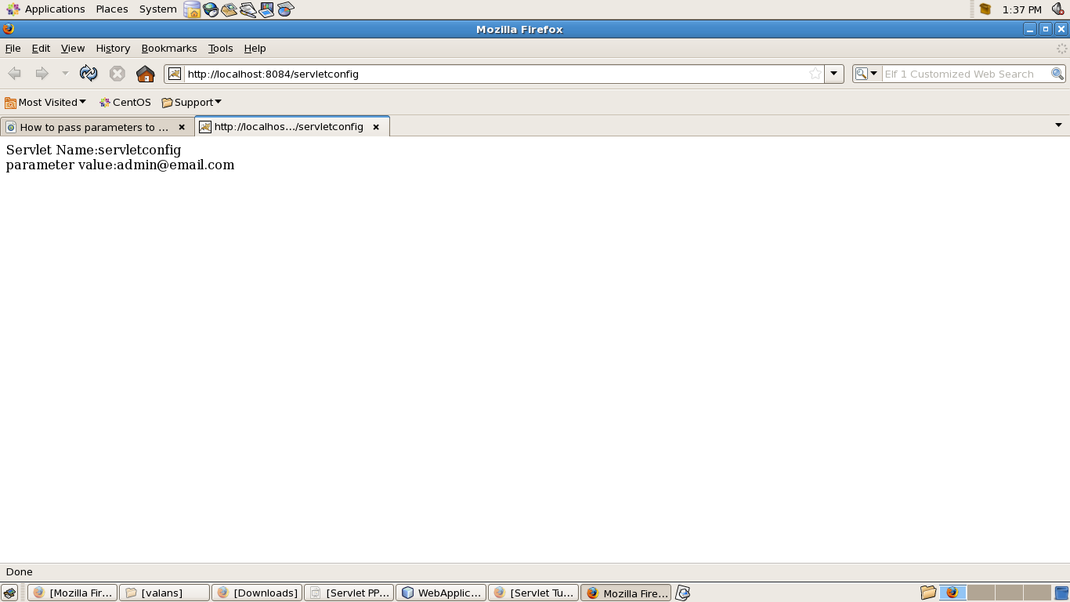
Output

Slide 56
Introduction to Servlet Context
For getting the information regarding the environment in which servlet are running, we incorporate ServletContext interface. The context is also called as servlet context or Web context and is created by the Web container as an object of the ServletContext interface.
For each web application, there is only one ServletContext and it is accessible to all the active resources of that application. This context is also used to share information with one another.
Every web application has exactly one instance of javax.servlet.ServletContext . The context is initialized at the time that the web application is loaded.

Slide 57
Adding Parameter to Servlet context
In this section, you will learn how to sets a JDBC URL as a context attribute using setAttribute() method.
import javax.servlet.*; import java.io.*;
public class SetContext extends GenericServlet {
ServletContext ctx;
public void init(ServletConfig cfig) {
ctx = cfig.getServletContext(); /* Obtain the ServletContext object */
}
public void service(ServletRequest request, ServletResponse response)
throws ServletException, IOException {
ctx.setAttribute("URL", "jdbc:odbc:EmployeesDB"); // Set the context attribute
PrintWriter pw = response.getWriter();
response.setContentType("text/html");
pw.println("The JDBC URL has been set as a context attribute");
} }

Slide 58
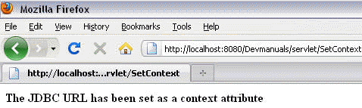
Output

Slide 59
Getting Parameter from Servlet Context
In this section, you will learn how to get a JDBC URL as a context attribute using getAttribute() method.
import javax.servlet.*; import java.io.*;
public class GetCntx extends GenericServlet {
ServletContext ctx;
String url;
public void init(ServletConfig cfig) {
ctx = cfig.getServletContext();
}
public void service(ServletRequest request, ServletResponse response)
throws ServletException, IOException {
url = (String) ctx.getAttribute("URL");
PrintWriter pw = response.getWriter();
response.setContentType("text/html");
pw.println("The URL value is : " + url + " ");
} }

Slide 60
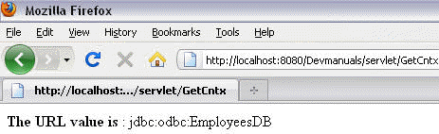
Output

Slide 61
JDBC

Slide 62
JDBC
Load the driver class
Get a connection
Create a statement
Execute the query, returns ResultSet
Iterate through ResultSet

Slide 63
JDBC Example
// Load the Oracle JDBC driver
Class.forName ("oracle.jdbc.driver.OracleDriver");
//Connect to DB server as authorized user
Connection conn = DriverManager.getConnection ("jdbc:oracle:thin:@orion.towson.edu:1521:cosc", account, password);
// Create a JDBC Statement to hold SQL query
Statement stmt = conn.createStatement ();
ResultSet rset = stmt.executeQuery ("select ticker from stocks");
// Iterate through the result and print the employee names
while (rset.next ()) {
out.println (rset.getString (1));
}

Slide 64
Servlet filters

Slide 65
Servlet filters
A filter is an object than perform filtering tasks on either the request to a resource (a servlet or static content), or on the response from a resource, or both.
Filters not create a response like servlet.
It process request before it reaches to a servlet and can process response before it leaves to a servlet.

Slide 66
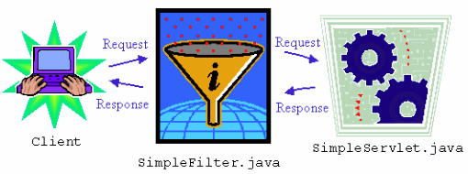
Servlet Filters Cont..

Slide 67
javax.servlet.Filter
For implementing servlet we need to import javax.servlet.Filter . This interface defines three methods :
* void init(FilterConfig config)
Sets the filter's configuration object.
* void destroy() :
For destroying the filter's configuration instance.
* void doFilter(ServletRequest req, ServletResponse res, FilterChain chain) throws IOException, ServletException:
Perform the actual filter work.

Slide 68
javax.servlet.Filter Cont
Filters perform filtering in the doFilter method. Every Filter has access to a FilterConfig object from which it can obtain its initialization parameters.
FilterConfig – This object acts as configuration object for filter which pass information to filter during initialization. For eg, you may set initialization parameters in web.xml file for filter which could be accessed from this object.
FilterChain – This object is again created by servlet container which provides a convenient method to invoke next filter in the chain or final resource. The method is doFilter (ServletRequest request, ServletResponse response). Suppose one servlet is attached with two filters. In first filter calling doFilter() method of FilterChain object invokes second filter and calling the method in second filter invokes servlet itself.

Slide 69
doFilter()
* This method is called by servlet container for every request/response. In doFilter() method, the following steps are executed.
1. When a client makes HTTP request to a resource, the servlet container checks whether it is associated with filter.
2. If yes, the filter’s doFilter method is called.
3. Inside doFilter() method we may intercept request object and may modify the same. After that we call doFilter() method of FilterChain object. Here it invokes next filter in chain. If no more filters are available, final resource (Servlet, JSP etc) is called.
4. The resource like Servlet or JSP process the request and send response back to client. This again is passed through doFilter method of filter object. All statements written after doFilter() method of chain object is executed again.
5. Finally the response is sent back to client

Slide 70
Example

Slide 71
Jsp File
<html>
<body>
<form action="MyServlet">
<input type="text" name="t1"/>
<input type="submit" value="FilterDemo"/>
</form>
</body>
</html>

Slide 72
MyServlet
public class MyServlet extends HttpServlet {
@Override
protected void doGet(HttpServletRequest request, HttpServletResponse response)
throws ServletException, IOException {
response.setContentType("text/html");
PrintWriter out = response.getWriter();
out.println("Welcome "+request.getParameter("t1"));
}
}

Slide 73
MyFilter
public class MyFilter implements Filter {
ArrayList list;
public void init(FilterConfig fn){
list=new ArrayList(); list.add(new String("Raj"));
list.add(new String("Kumar")); list.add(new String("Raju")); }
public void doFilter(ServletRequest request, ServletResponse response,FilterChain chain)throws IOException, ServletException {
response.setContentType("text/html");
PrintWriter out = response.getWriter();
HttpServletRequest req=(HttpServletRequest)request;
String userName=req.getParameter("t1");
if(list.contains(userName)){
out.println("In Valid User Name"); return ; }
chain.doFilter(request, response); }
public void destroy(){} }

Slide 74
Web.xml
<servlet>
<servlet-name>MyServlet</servlet-name>
<servlet-class>Pack.MyServlet</servlet-class>
</servlet>
<servlet-mapping>
<servlet-name>MyServlet</servlet-name>
<url-pattern>/MyServlet</url-pattern>
</servlet-mapping>

Slide 75
Web.xml
<filter>
<display-name>MyFilter</display-name>
<filter-name>MyFilter</filter-name>
<filter-class>Pack.MyFilter</filter-class>
</filter>
<filter-mapping>
<filter-name>MyFilter</filter-name>
<url-pattern>/MyServlet</url-pattern>
</filter-mapping>

Slide 76
Servlet Listeners

Slide 77
What is Listener?
Listener is basically pre-defined interfaces that are available for developers in the application lifecycle to achieve some tasks especially when dealing with the ServletContext as well as HttpSession objects.
There are two Listeners that are widely used ServletContextListener HttpSessionListener.

Slide 78
ServletContextListener
ServletContextListener will be executed once your web application is deployed in your application server (Tomcat or etc).
If you have any requirements that need to be executed before the application is started, ServletContextListener is the best place for you.
ServletContextListener also detects when your web application is removed.
public void contextInitialized(ServletContextEvent arg0)
public void contextDestroyed(ServletContextEvent arg0)

Slide 79
HttpSessionListener
Unlike ServletContextListener, HttpSessionListener deals with the HttpSession object.
HttpSession object are always used in every web application and are very useful in maintaining the data as it is available throughout the lifecycle of the web application until it is invalidated or the user closes the browser.
public void sessionCreated(HttpSessionEvent arg0)
public void sessionDestroyed(HttpSessionEvent arg0)

